Slide 1

MEDIA & THE PUBLIC
Week 6 Knowledge gap across media modalities
Ryan Wang
ryanyang@psu.edu

Slide 2
Boukes & Vliegenthart (2019): The Knowledge Gap Hypothesis Across Modality: Differential Acquisition of Knowledge from Television News, Newspapers, and News Websites

Slide 3
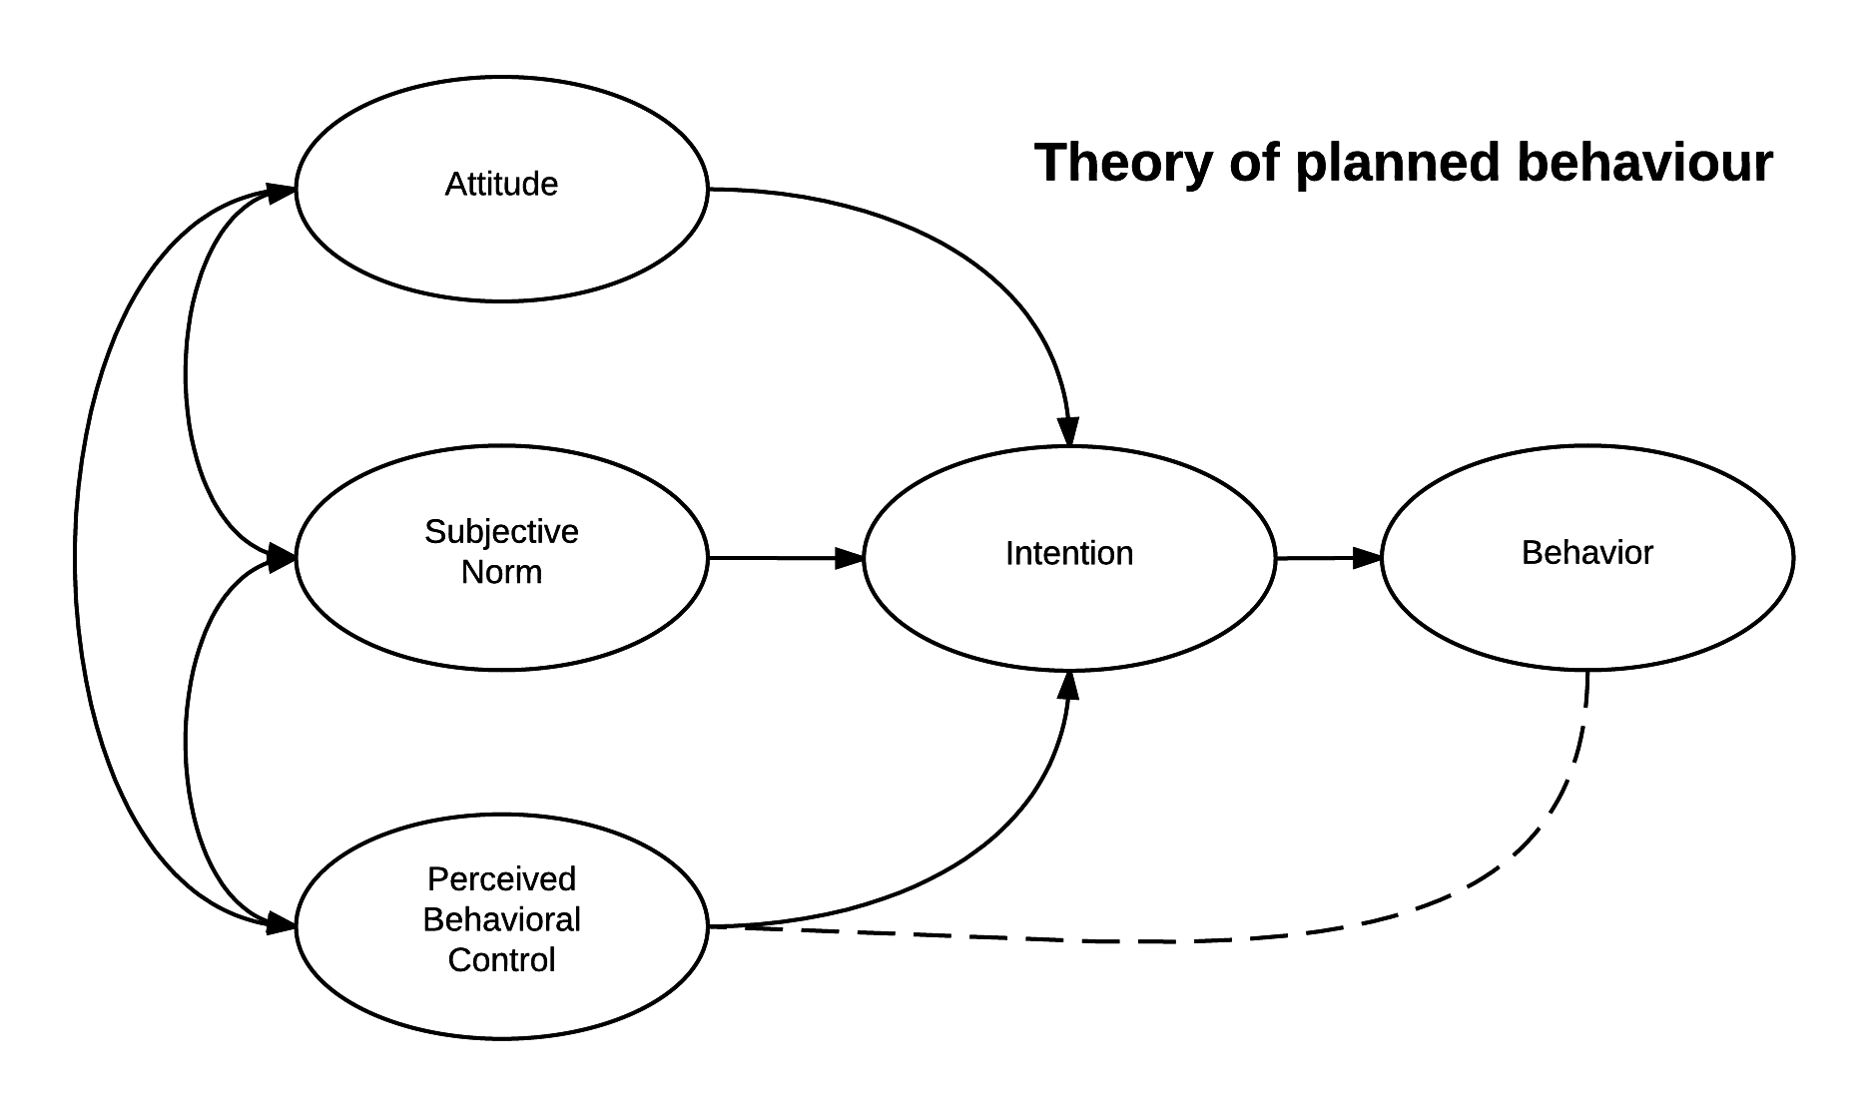
Theory of planned behavior (Ajzen, 1991)

Slide 4
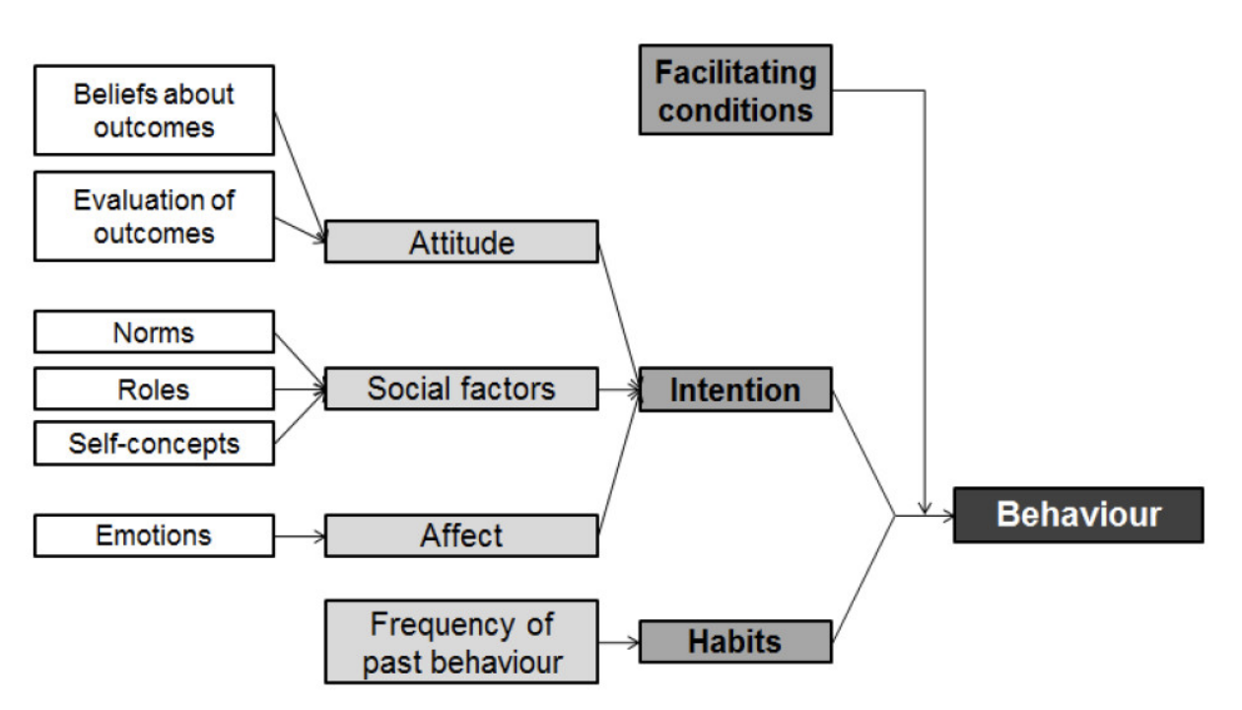
Triandis’s Model of choice (1977)

Slide 5
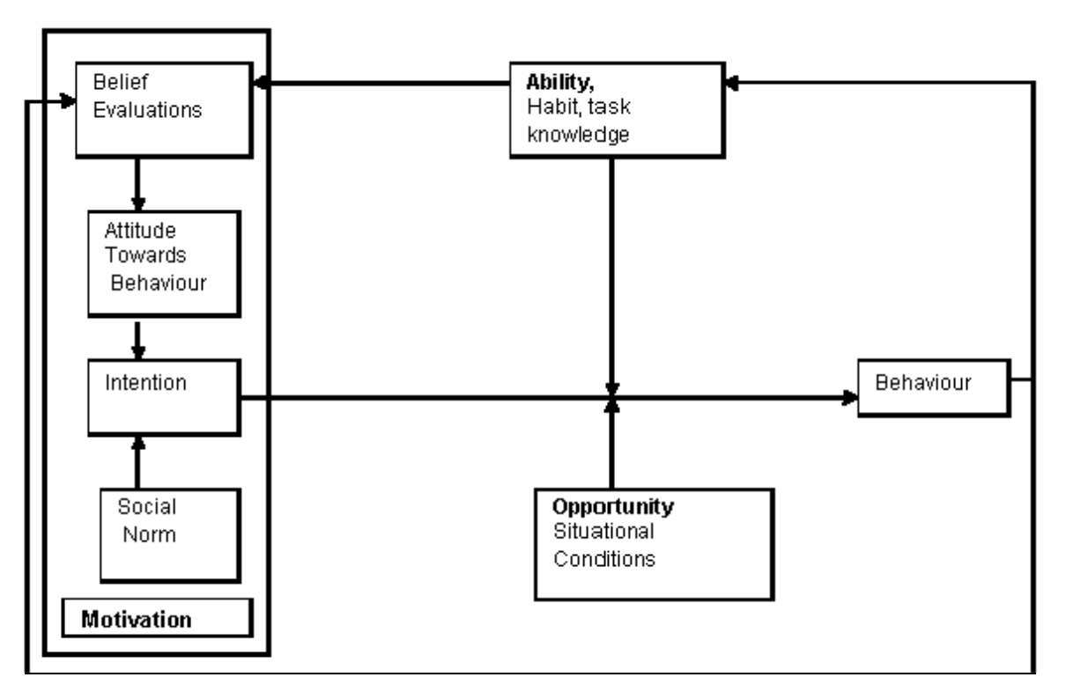
O-M-A framework
Opportunities–motivation–ability framework (O-M-A; Ölander and Thøgersen , 1995))

Slide 6
O-M-A framework
How much citizens learn from the news media:
Opportunity: The availability of news in one’s personal environment and geographical context
Motivation: Individual citizens’ motivation to seek out news within the abundance of media choice
Ability: Citizens’ ability to learn from the exposure to news coverage

Slide 7
Knowledge gap hypothesis (over time)
Moderator
Time
Level of media exposure
Knowledge gap
Independent variable
Dependent variable
Notes:
At one point in time knowledge differentials between higher and lower social segments for highly publicized subjects were expected to be relatively large, with those for less well publicized issues relatively small.
Over time the relationship between education and knowledge was predicted to increase at a greater rate for topics that received high media attention. The independent variable was level of media publicity, and the depen- dent variable was the relationship between socioeconomic status (SES) and knowledge, or the knowledge gap. If this gap is measured over time, time is a moderator variable because it influences the strength of the relationship between SES and the knowledge differential.

Slide 8
What are the main points of this paper?
Goal: which citizens acquire the most knowledge from the consumption of news media produced in different modalities, such TV news (audio-visual), Newspaper(textual), and News websites (mixed)
Research questions and hypotheses:
H1: The consumption of (a) television news, (b) newspapers, and (c) news websites positively affects the acquisition of current affairs knowledge.
H2: The consumption of television news has a positive effect on the acquisition of current affairs knowledge that is stronger for citizens with lower levels of ability.
H3: The consumption of newspapers has a positive effect on the acquisition of current affairs knowledge that is stronger for citizens with higher levels of ability.
RQ: How does the consumption of news websites affect the acquisition of current affairs knowledge differently for citizens with higher versus lower levels of ability?

Slide 9
Measurement
Dependent variable
knowledge of current affair (a cumulative measure that reflects the growth of knowledge over time)
1st wave: five multiple-choice questions on different topics were asked to measure citizens’ existing level of knowledge of current affairs.
2nd and 3rd wave: two additional questions were asked that focused on new information (i.e., information that very unlikely or impossibly could be known before the previous survey wave
Independent variable
News consumption
“How many times per week or per month respondents watched certain TV programs, read certain newspapers, or visited certain news websites” (0-7)
Moderator
Citizen’s level of education
“What is the highest degree or level of school you have followed ?” (0-6)
(Time)?
Control variables
Age, gender, political ideology, internal efficacy, political trust, and political interest (motivation), frequency of talking with others about current affairs

Slide 10
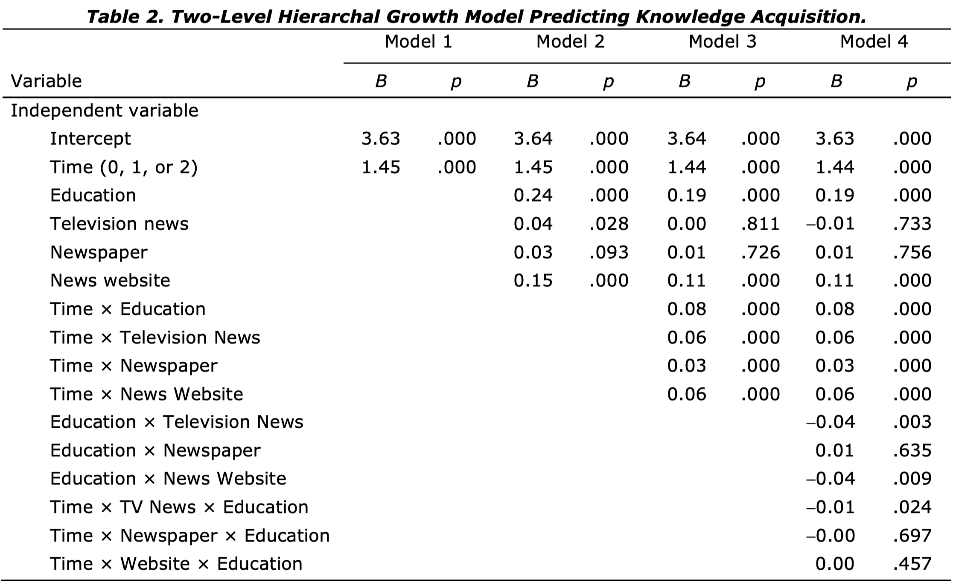
What are the main results
H1(a)
H1(b)
H1(c)
H2
H3
RQ1

Slide 11
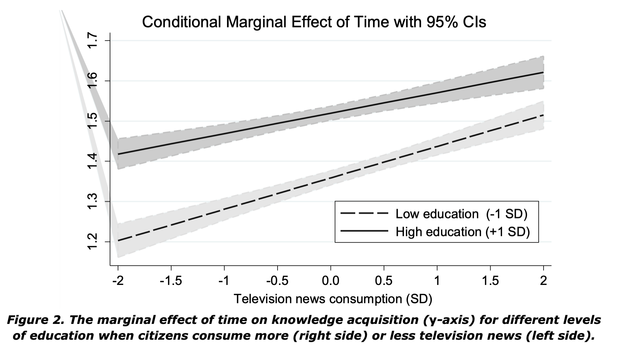
What are the main results

Slide 12
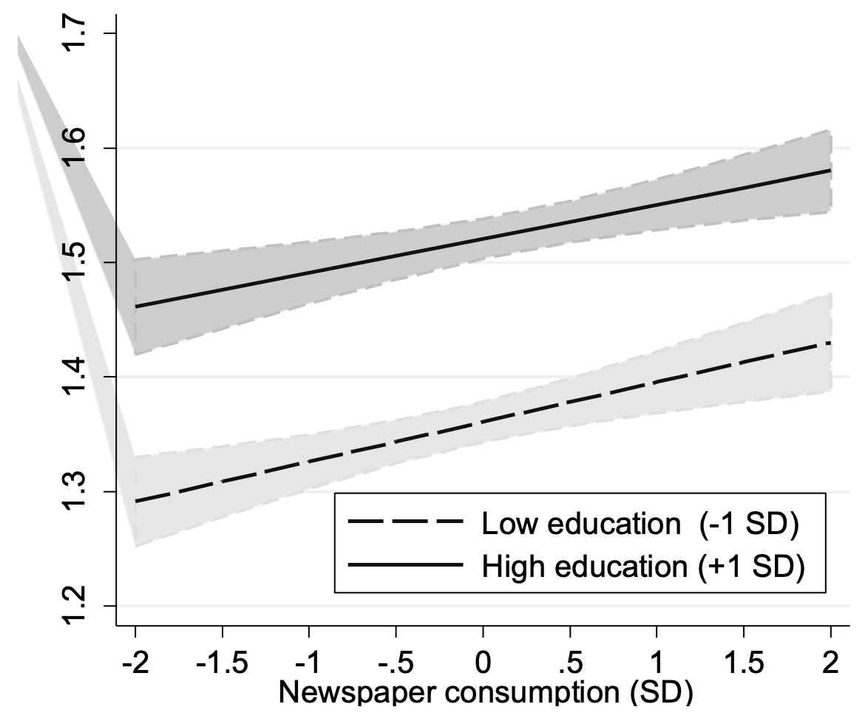
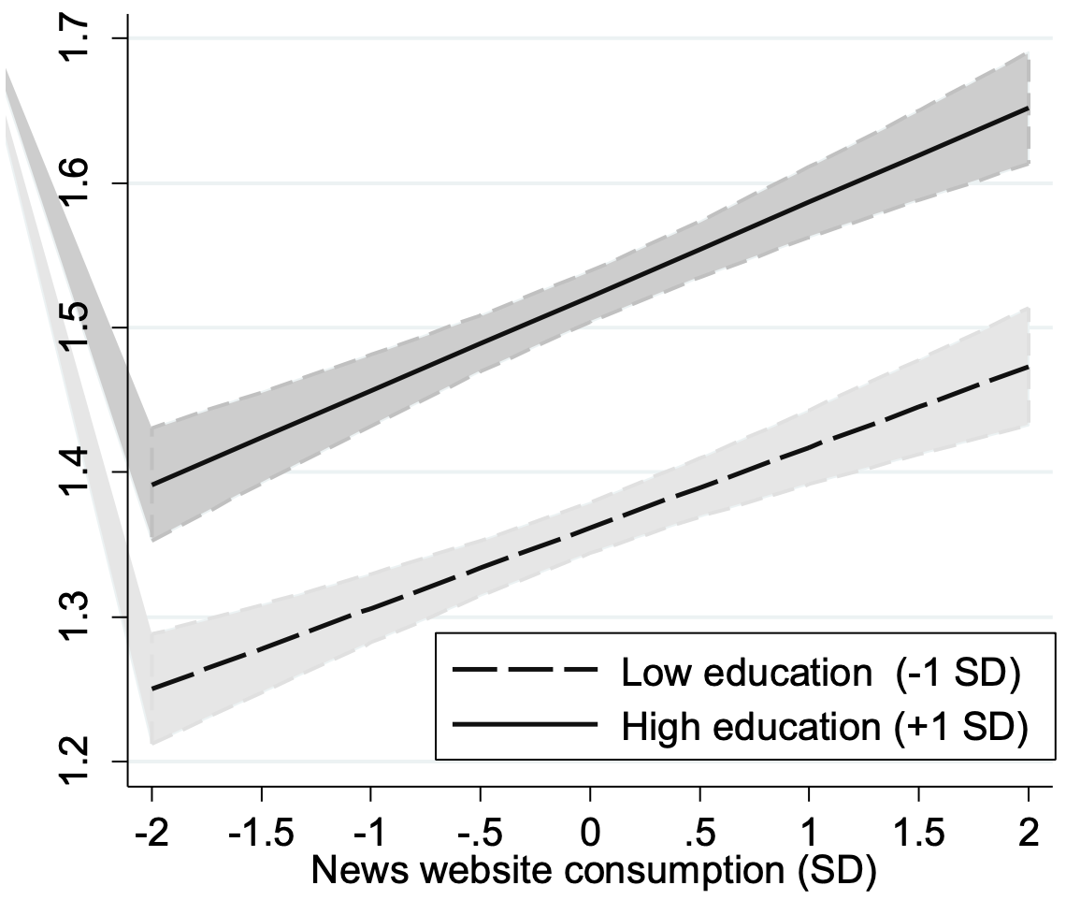
What are the main results

Slide 13
Key takeaway
News media modality matters in terms of the effects that news consumption has on the knowledge gap
When consuming more television news, knowledge acquisition increases the most for citizens with a lower level of education
Lower educated citizens benefit most from television news, which slows down the growth of a knowledge gap. Television, accordingly, lives up its potential to “bridge” the knowledge gap
Newspaper consumption neither further increases nor decreases the knowledge gap
The (in)ability of citizens to learn from textual news has become “less of a pertinent issue” due to rising education levels
The effect was neither found for the consumption of news websites
News presented online largely reflects the news that appears in printed outlets. Most of the news websites still present their news primarily in a textual format

Slide 14
Reference
Ajzen, I. (1991). The theory of planned behavior. Organizational Behavior and Human Decision Processes, 50(2), 179-211. https://doi.org/10.1016/0749-5978(91)90020-T
Ölander, F. & Thøgersen , J. (1995). Understanding of consumer behaviour as a prerequisite for environmental protection. Journal of Consumer Policy, 18, 345–385 (1995). https://doi.org/10.1007/BF01024160
Triandis, H. (1977). Interpersonal behavior. Monterey. Brooks/Cole Publishing

